Slide 1
Interactive Data Visualization
Part 2

Slide 2
Main Code
plot_ly(data = dataframe, x = ~name_of_variable1,
y = ~name_of_variable2,
color = ~name_variable3,
symbol = ~name_variable3,
type = "", mode = "",
colors = pallete_vector)

Slide 3
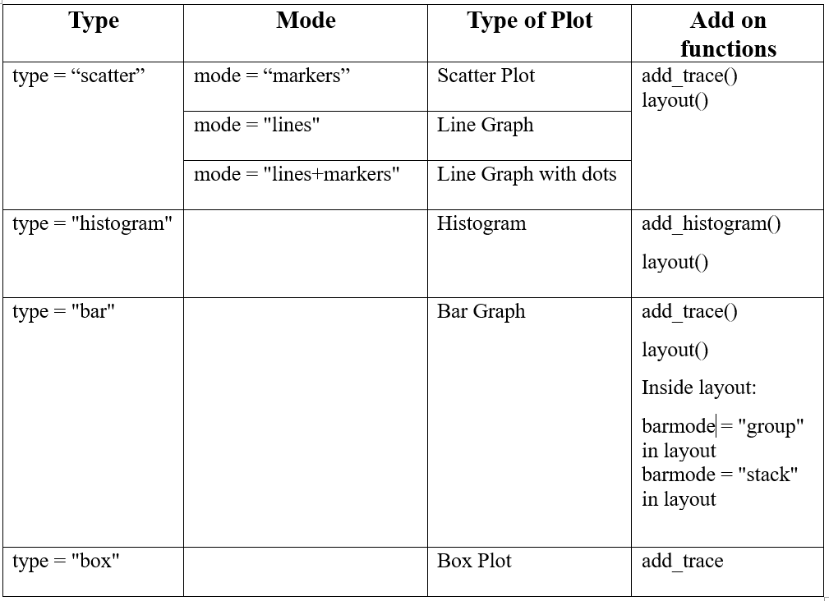

Slide 4
Histograms with Plotly

Slide 5
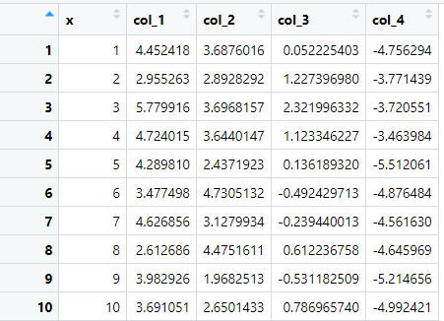
Dataframe: data_1

Slide 6
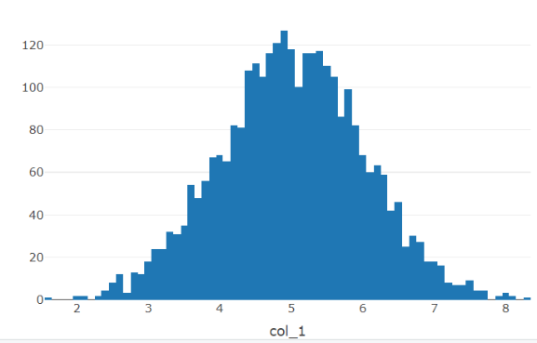
Simple Histogram
fig1 <- plot_ly(data = data_1, x = ~col_1,
type = "histogram", nbinsx = 100)
fig1

Slide 7
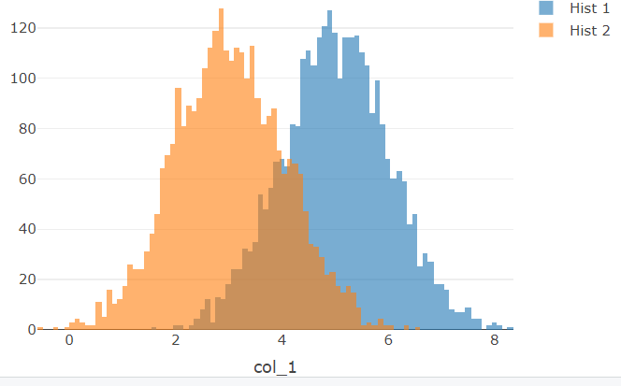
Overlaid Histogram (alpha controls the level of transparency)
fig2 <- plot_ly(data = data_1, x = ~col_1,
type = "histogram", alpha = 0.6, name = "Hist 1") %>%
add_histogram(x = ~col_2, name = "Hist 2") %>%
layout(barmode = "overlay")
fig2

Slide 8
Bar Graphs with Plotly

Slide 9
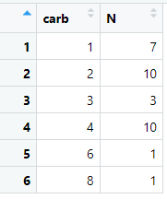
Dataframe: data_2

Slide 10
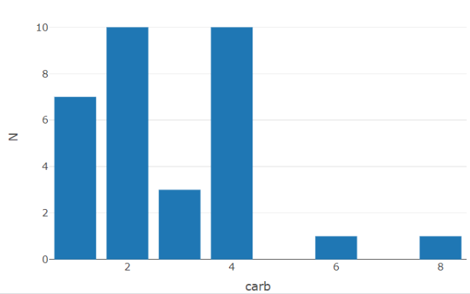
Simple Bar Graph
fig3 <- plot_ly(data = data_2,
x = ~carb, y = ~N,
type = "bar")
fig3

Slide 11
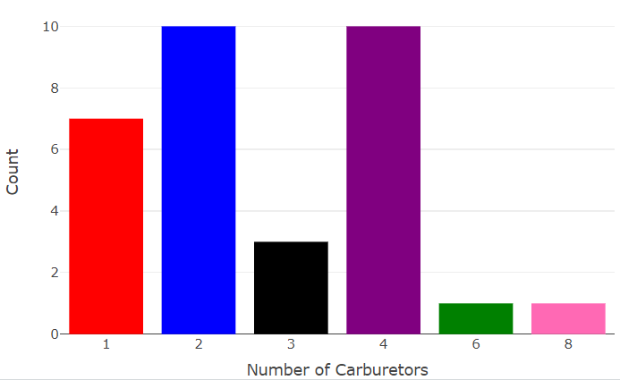
Changing colors in a Bar Graph
fig4 <- plot_ly(data = data_2,
x = ~factor(carb), y = ~N,
type = "bar",
marker = list(color = c("red", "blue", "black",
"purple", "green", "hotpink"))) %>%
layout(xaxis = list(title = "Number of Carburetors"),
yaxis = list(title = "Count"))
fig4

Slide 12
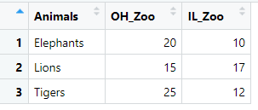
Dataframe: data_3

Slide 13
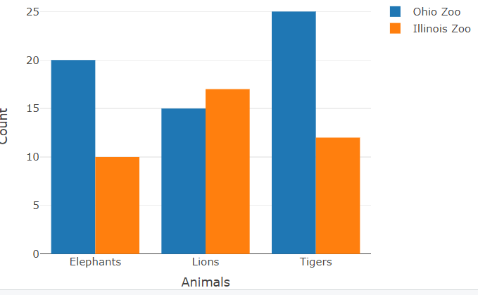
Grouped Bar Graph
fig5 <- plot_ly(data = data_3, x = ~Animals, y = ~OH_Zoo,
type = "bar", name = "Ohio Zoo") %>%
add_trace(y = ~IL_Zoo, name = "Illinois Zoo") %>%
layout(yaxis = list(title = "Count"),
barmode = "group")
fig5

Slide 14
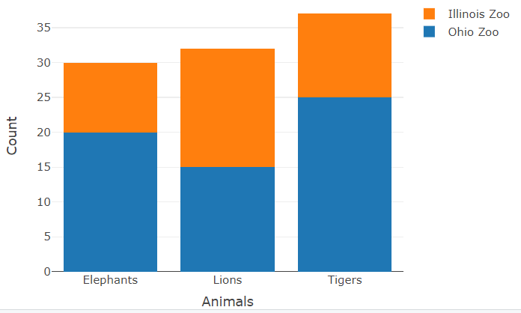
Stacked Bar Graph
fig6 <- plot_ly(data = data_3, x = ~Animals, y = ~OH_Zoo,
type = "bar", name = "Ohio Zoo") %>%
add_trace(y = ~IL_Zoo, name = "Illinois Zoo") %>%
layout(yaxis = list(title = "Count"),
barmode = "stack")
fig6

Slide 15
Boxplots with Plotly

Slide 16
Dataframe: data_1

Slide 17
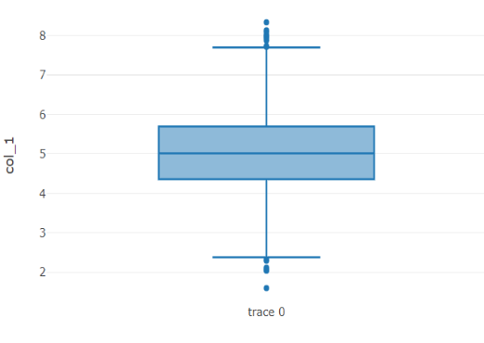
Vertical Boxplot
fig7 <- plot_ly(data = data_1, y = ~col_1,
type = "box")
fig7

Slide 18
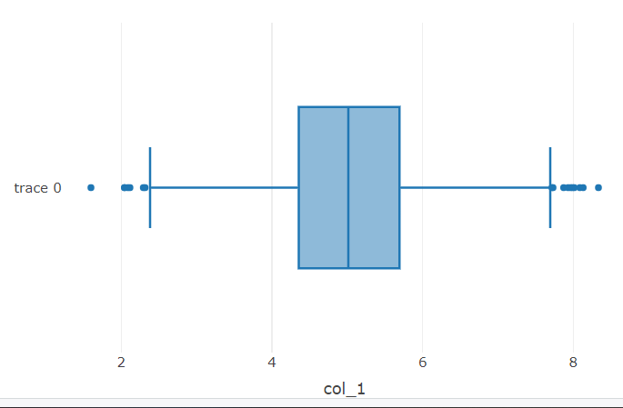
Horizontal Boxplot
fig8 <- plot_ly(data = data_1, x = ~col_1,
type = "box")
fig8

Slide 19
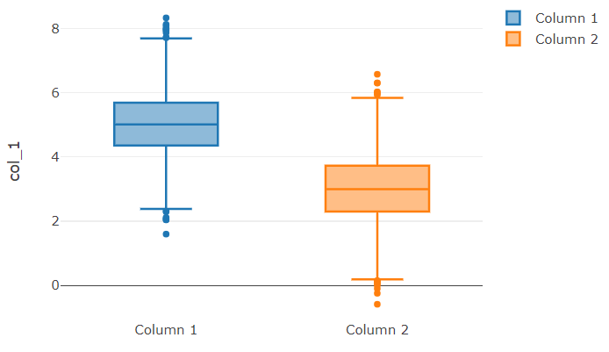
Multiple Boxplots
fig9 <- plot_ly(data = data_1, y = ~col_1,
type = "box", name = "Column 1") %>%
add_trace(y = ~col_2, name = "Column 2")
fig9

Slide 20
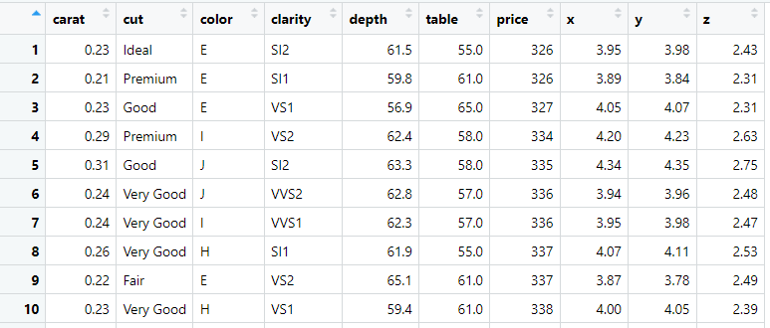
Dataframe: diamonds

Slide 21
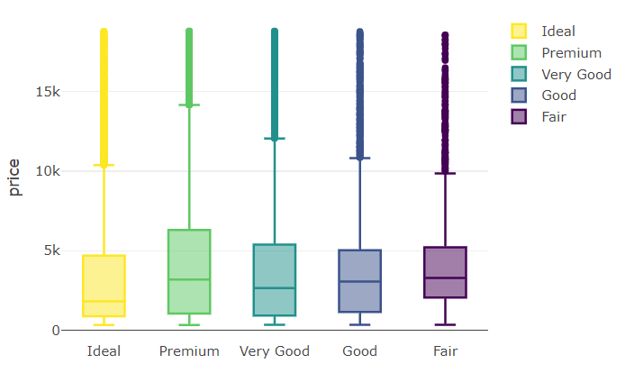
Multiple Boxplots by Categorical Variable
fig10 <- plot_ly(data = diamonds,
y = ~price, color = ~cut, type = "box")
fig10

Slide 22
Interactive Tables with Datatable

Slide 23
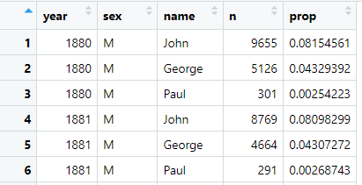
Dataframe: Beatles
data("babynames")
Beatles <- babynames %>%
filter(name %in% c("John", "Paul", "George", "Ringo") & sex == "M")

Slide 24
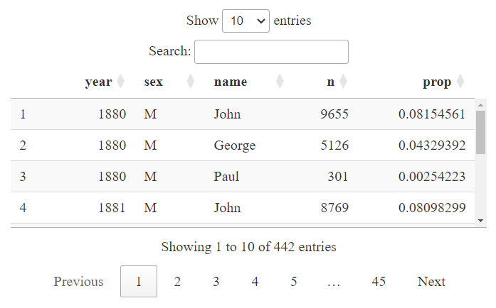
In this section, an interactive table is generated using the DT package. With the function datatable() we will turn a dataframe into an interactive table.
interactive_table <- datatable(Beatles, options = list(pageLength = 10))
interactive_table

Slide 25
Dygraph

Slide 26
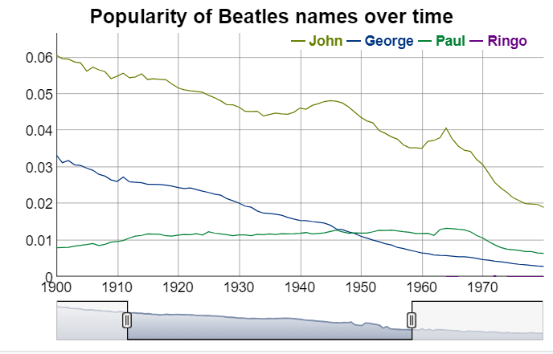
fig11 <- Beatles %>%
select(year, name, prop) %>%
pivot_wider(names_from = name, values_from = prop) %>%
dygraph(main = "Popularity of Beatles names over time") %>%
dyRangeSelector(dateWindow = c("1900", "1980"))
fig11

